Slide 1
How were mummies made?
Mini-lesson for schools

Slide 2
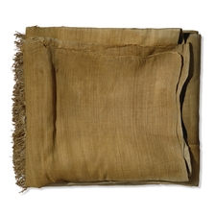
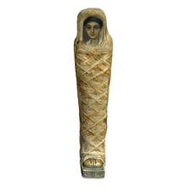
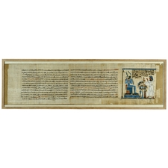
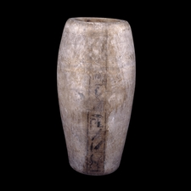
Herodotus (a famous ancient Greek historian) described mummification. His words provide us with written evidence of this process. The British Museum contains objects and documents which also help us to understand how mummies were made.
Herodotus wrote that “as much as possible of the brain is taken out through the nostrils with an iron hook. What the hook cannot reach is rinsed out with drugs.”
Ancient Egyptians did not understand what the brain was for. They needed to take it out to preserve the body.
Notes:
AN32897001
AN35346001
AN31749001
AN35805001
AN32884001
Quote from Greek historian Herodotus (about 485 – 425BC)
Linen from the burial of Sebekhetepi, about 2125-1795 BC, Beni Hasan, Egypt
Museum number: EA 41580
http://www.britishmuseum.org/explore/highlights/highlight_objects/aes/l/linen_from_sebekhetepi_burial.aspx
Papyrus from the Book of the Dead of Padiamenet, around 1000 BC, Egypt
Museum number: EA 10063
http://www.britishmuseum.org/explore/highlights/highlight_objects/aes/p/papyrus_from_the_book_of_the-9.aspx
Canopic jar of Horudja, 747-525 BC, Egypt
Museum number: EA 37937
http://www.britishmuseum.org/explore/highlights/highlight_objects/aes/c/canopic_jar_of_horudja.aspx
Mummy of a young boy with portrait panel, AD 100-120, Hawara in Egypt
Museum number: EA 13595
http://www.britishmuseum.org/explore/highlights/highlight_objects/aes/m/mummy_of_a_young_boy_with_a_po.aspx
Bronze probe, after 664 BC, Egypt
Museum number: EA36678
http://www.britishmuseum.org/explore/highlights/highlight_objects/aes/b/bronze_probe.aspx

Slide 3
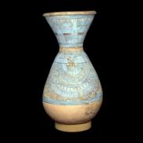
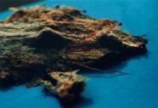
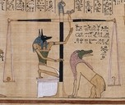
Herodotus tells us the next step: “the side is cut open with a flint knife and the whole contents of the abdomen removed. The space is then thoroughly cleansed and washed out, first with palm wine and again with liquid containing spices. After that, the space in the body is filled with pure myrrh, cassia, and other perfumes except frankincense and sewn up again”
They left the heart inside the body. It would be needed during the journey to the afterlife where it was weighed against the feather of truth.
Notes:
AN32843001
AN409781
AN37335001
Bronze tweezers, after 664 BC, Egypt
Museum number: EA38151
http://www.britishmuseum.org/explore/highlights/highlight_objects/aes/b/bronze_tweezers.aspx
Pottery jar, around 1300 BC, El-Armana in Egypt
Museum number: 1924,1011.174
Painted jar with blue lotus decoration and echoes of the elaborate collars worn by wealthy Egyptians.
Page from the Book of the Dead of Hunefer, around 1275 BC, Thebes in Egypt
Museum number: EA 9901/3
http://www.britishmuseum.org/explore/highlights/highlight_objects/aes/p/page_from_the_book_of_the_dead.aspx

Slide 4
The organs could be placed in Canopic jars to keep them safe.
Qebehsenuef the falcon-headed god looks after the intestines.
Which organ goes in each canopic jar? Look at the heads.
Hapy the baboon-headed god looks after the lungs.
Notes:
AN30953001
Painted wooden canopic jars, around 700 BC, Egypt
Museum numbers: EA 9562-5
http://www.britishmuseum.org/explore/highlights/highlight_objects/aes/p/painted_wooden_canopic_jars.aspx

Slide 5
Duamutef the jackal-headed god looks after the stomach.
Imsety the human-headed god looks after the liver.

Slide 6
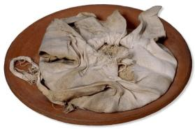
Herodotus writes: “Then the body is placed in natrum, covered entirely over”.
Natron is a natural salt. This dehydrated (dried out) the body and stopped it rotting. This made sure the body was preserved.
Notes:
AN32886001
Linen bag of salt for mummification, 1550-1070 BC, Deir el-Bahari, Egypt.
Museum number: 1906,1013.154
http://www.britishmuseum.org/explore/highlights/highlight_objects/aes/l/linen_bag_of_salt_for_mummific.aspx

Slide 7
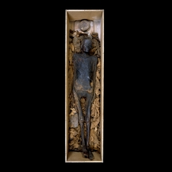
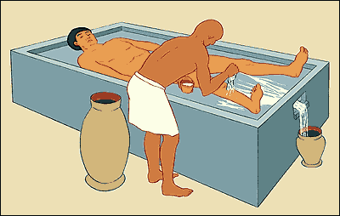
Herodotus continues: “when this period is over, the body is washed”
Notes:
AN33151001
AN30980001
Unwrapped body of a woman, after 600 BC, Egypt
Museum number: EA 24957
http://www.britishmuseum.org/explore/highlights/highlight_objects/aes/u/unwrapped_mummy_of_a_woman.aspx
Faience perfume jar in the shape of a lotus bud, 1300 BC, Sudan
Museum number: 64041
http://www.britishmuseum.org/explore/highlights/highlight_objects/aes/f/faience_perfume_vase_in_the_sh.aspx

Slide 8
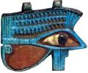
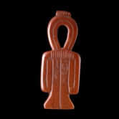
Herodotus says that the body is “then wrapped from head to foot in linen cut into strips and smeared with gum, which is often used by the Egyptians instead of glue.”
Amulets were placed in the mummy wrappings. These were like good luck charms and were used to protect the body.
The body was wrapped very carefully to look like a human figure. This shape could be used in the afterlife if the person’s body did not survive very well.
Notes:
AN36132001
AN102344001
AN33225001
AN32656001
Strip of decorated linen, after 1550BC, Egypt.
Museum number: EA 6517
http://www.britishmuseum.org/explore/highlights/highlight_objects/aes/s/strip_of_decorated_linen.aspx
Mummy of a female, between 950 BC and 650 BC, Egypt
Museum number: EA 6666
Female mummy in the coffin of Pasherihoraawesheb, a male. It is thought that the female was placed in the coffin in more modern times. Estimated that a mummy such as this required up to 448 square yards of linen wrappings.
Red jasper tit amulet of Nefer, 1250-1100 BC, Egypt
Museum number: EA 20639
http://www.britishmuseum.org/explore/highlights/highlight_objects/aes/r/red_jasper_tit_amulet_of_nefer.aspx
Faience wedjat eye, 1069-945 BC, Egypt
Museum number: EA 26300
http://www.britishmuseum.org/explore/highlights/highlight_objects/aes/f/faience_wedjat_eye.aspx

Slide 9
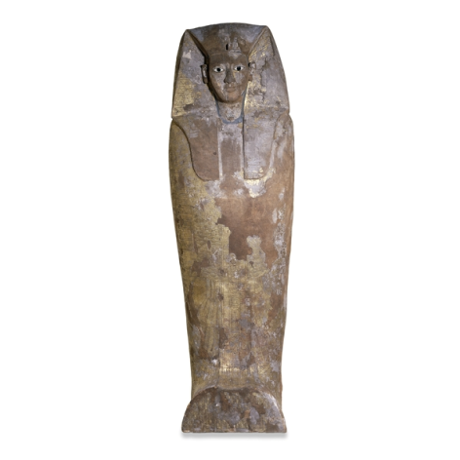
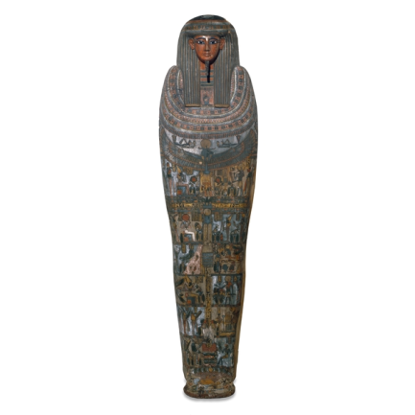
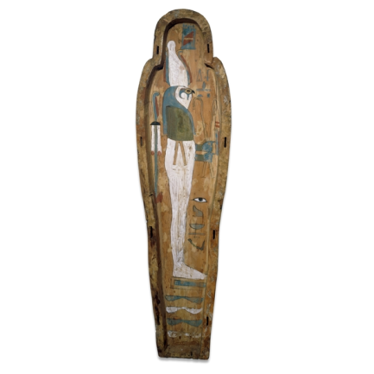
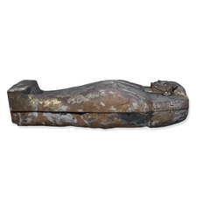
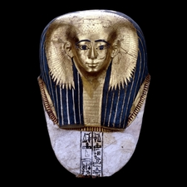
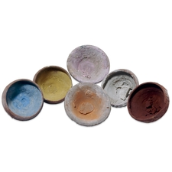
Herodotus writes that “the body is given back to the family, who have it put into a wooden case shaped like the human figure.”
The coffin could be painted on the inside and outside.
It could also be decorated with gold.
Notes:
AN33228001
AN31232001
AN34759001
AN34753001
AN34736001
AN37565001
AN30973001
Mummy of King Nubkheperra Intef, around 1600 BC, Thebes in Egypt
Museum number: EA 6652
http://www.britishmuseum.org/explore/highlights/highlight_objects/aes/c/coffin_of_king_nubkheperra_int.aspx
Mummy and coffin of Hor, around 650BC, Egypt
Museum number: EA 6659
http://www.britishmuseum.org/explore/highlights/highlight_objects/aes/m/mummy_and_coffin_of_hor.aspx
Six pottery bowls containing different coloured pigments, Roman 1st century AD, Hawara in Egypt
Museum numbers: 1888.9-20.23, 1888.9-20.24,1888.9-20.25, 1888.9-20.26, 1888.9-20.27, 1888.9-20.28
http://www.britishmuseum.org/explore/highlights/highlight_objects/gr/s/six_pottery_bowls.aspx
Mummy mask of Satdjehuty, about 1500 BC, Thebes in Egypt
Museum number: EA 29770
http://www.britishmuseum.org/explore/highlights/highlight_objects/aes/m/mummy_mask_of_satdjehuty.aspx
Inner coffin of Henutmehyt, around 1250 BC, Thebes in Egypt
Museum number: EA 48001
http://www.britishmuseum.org/explore/highlights/highlight_objects/aes/i/inner_coffin_of_henutmehyt.aspx

Slide 10
The family then took the coffin to the tomb with the hope that the dead person would reach the afterlife.
tomb
mummy
family
objects for the tomb
Notes:
AN36522001
Page from the Book of the Dead of Hunefer, around 1275 BC, Thebes in Egypt
Museum number: EA 9901 sheet 5
http://www.britishmuseum.org/explore/highlights/highlight_objects/aes/p/page_from_the_book_of_the_de-1.aspx

Slide 11
Now you have finished…
Visit the main Museum website
www.britishmuseum.org

